Slide 1
Nominal parameters:
20 experiments of 2000 1-count samples, Gx^49
Frequencies are:
1.2, 6, 8.4, 9.6, 0.0, 0.0015, 0.003, 0.0045, 0.006
Corresponding amplitudes are:
0.002, 0.002, 0.0015, 0.0015, 0.0, 0.005, 0.01, 0.015, 0.02

Slide 2

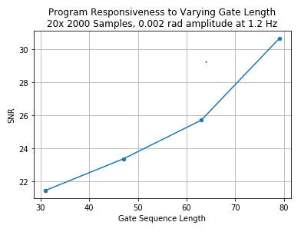
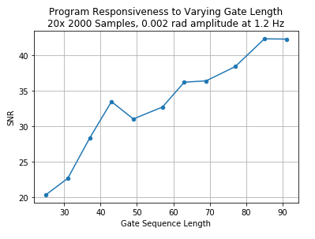


Slide 3

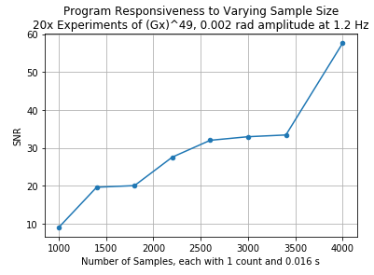
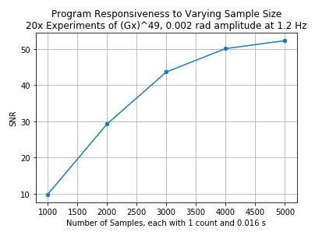


Slide 4
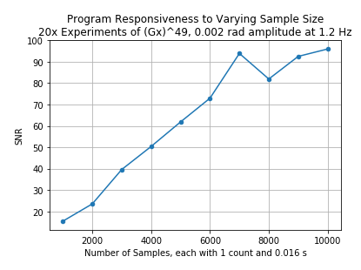


Slide 5
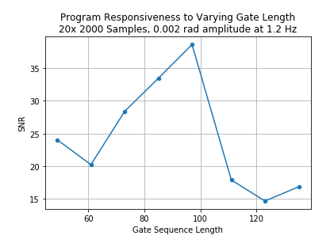

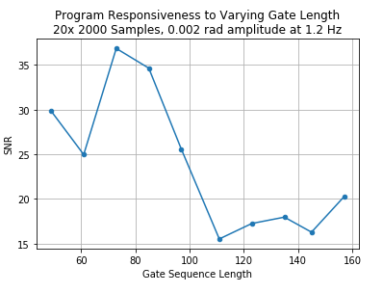


Slide 6

